Slide 1

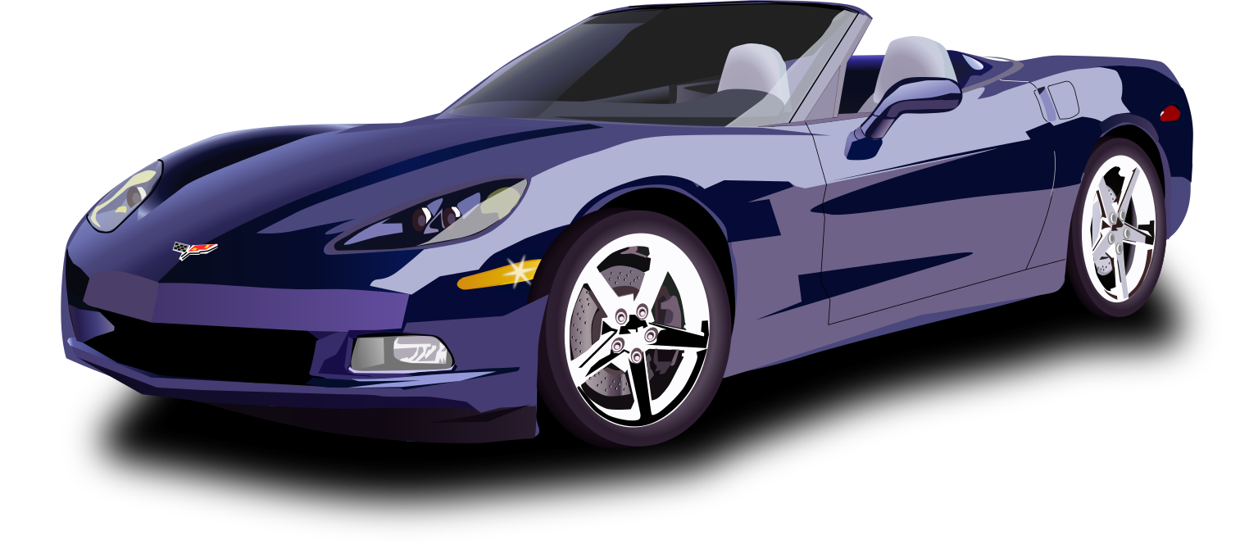
Digital Portfolio
STUDENT NAME: ZACHARIAH ROY
REGISTER NO AND NMID : 212402469 & 59B0519DE08B5C68C2D42ADB9EBEB007
DEPARTMENT: BCA
COLLEGE: AM JAIN COLLEGE
1

Slide 2


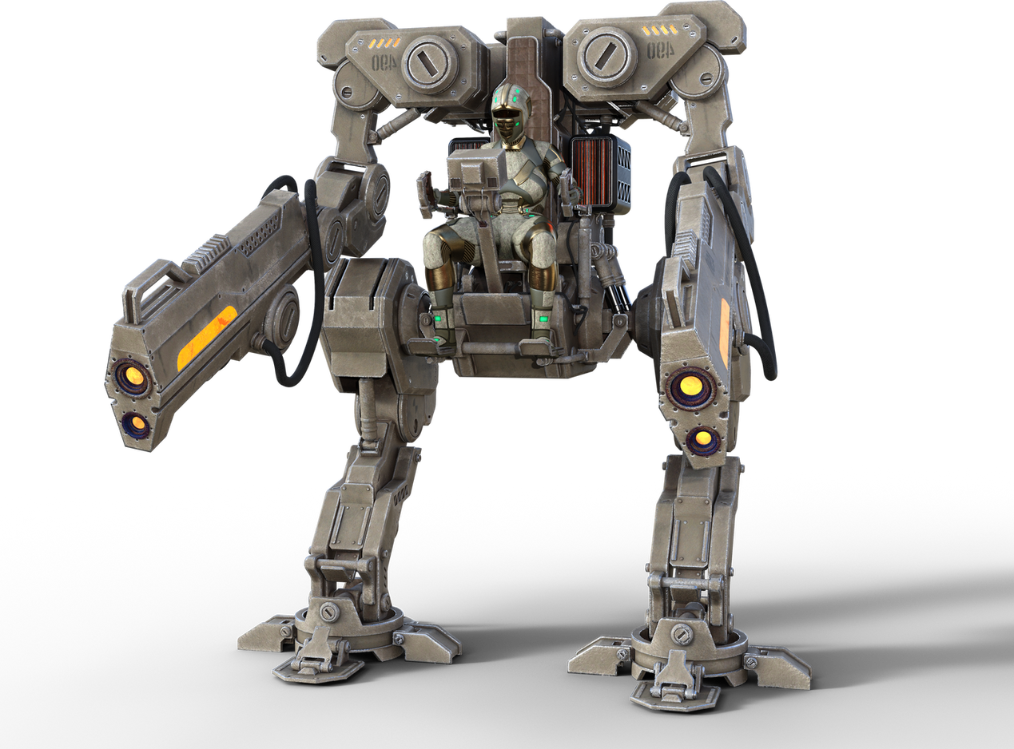
Digital Potfolio
2

Slide 3
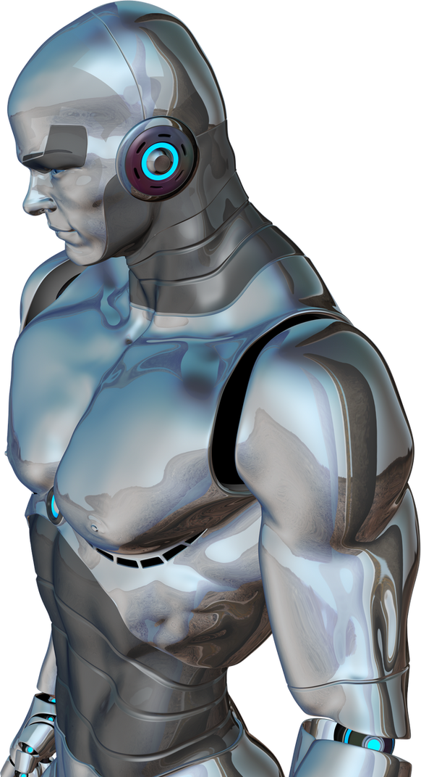


AGENDA
Problem Statement
Project Overview
End Users
Tools and Technologies
Portfolio design and Layout
Features and Functionality
Results and Screenshots
Conclusion
Github Link
3/21/2024 Annual Review
3

Slide 4

PROBLEM STATEMENT
Traditional resumes and static portfolios fail to showcase a developer’s skills, creativity, and interactive capabilities effectively. There is a need for a modern, responsive, and visually engaging digital portfolio that highlights technical expertise, projects, and contact information while providing an interactive user experience
4

Slide 5

PROJECT OVERVIEW
This is a personal portfolio website designed to present Zachariah Roy’s profile, skills, and projects. It provides a responsive, visually appealing neon-themed design, includes sections like About, Skills, Projects, Instagram, and Contact, and demonstrates frontend development capabilities with HTML, CSS, and JavaScript.
5

Slide 6


WHO ARE THE END USERS?
Recruiters and hiring managers
Potential clients
Collaborators and peers in the tech/design field
General audience interested in Zachariah’s work
6

Slide 7
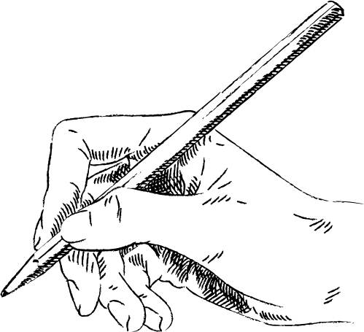
TOOLS AND TECHNIQUES
HTML5 – for content structure
CSS3 – for styling and responsive design
JavaScript (ES6+) – for interactivity
Font Awesome – for icons
Responsive Web Design principles – for mobile-friendly layouts
7

Slide 8

POTFOLIO DESIGN AND LAYOUT
Theme: Neon modern aesthetic with glowing effects
Sections:
Header & Navigation (sticky menu with links)
Hero Section (intro with CTA button)
About Section (personal introduction with image)
Skills Section (grid of skills with hover animations)
Projects Section (cards with images, descriptions, and links)
Instagram Section (social profile highlight)
Contact Section (form + contact info)
Footer (social media links)
Layout: Grid and flexbox-based, fully responsive
8

Slide 9
FEATURES AND FUNCTIONALITY
Smooth scrolling navigation
Interactive skill highlights with neon glow effect
Responsive design for desktop and mobile
Project showcase with hover animations
Instagram profile integration with CTA button
Contact form with validation and submission alert
Mobile menu toggle (hamburger menu)

Slide 10
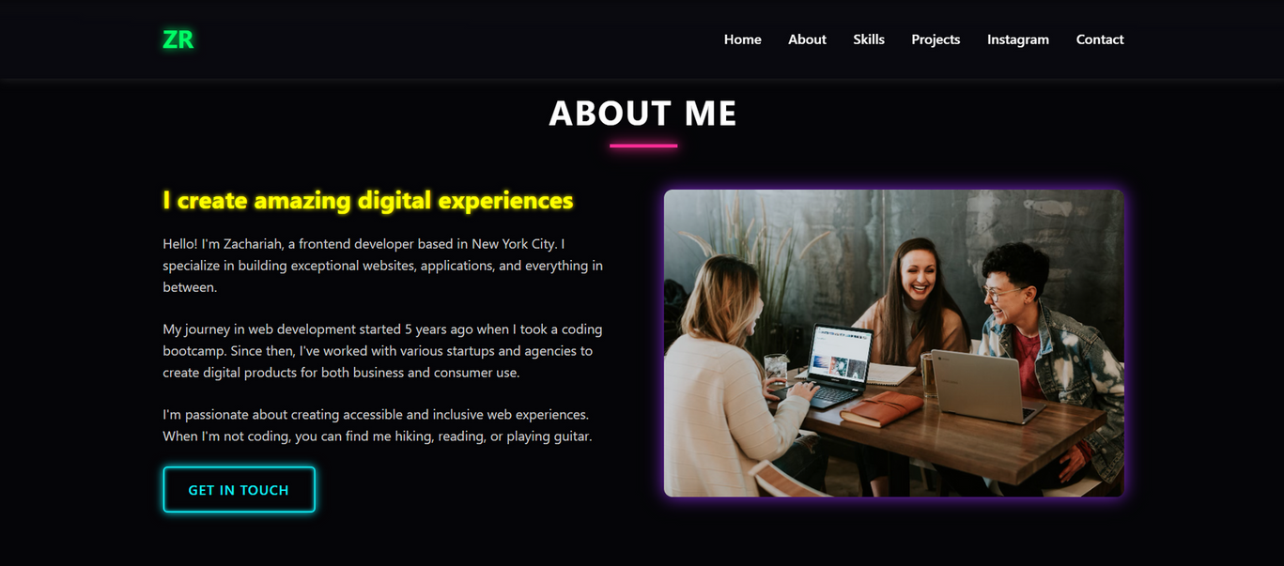
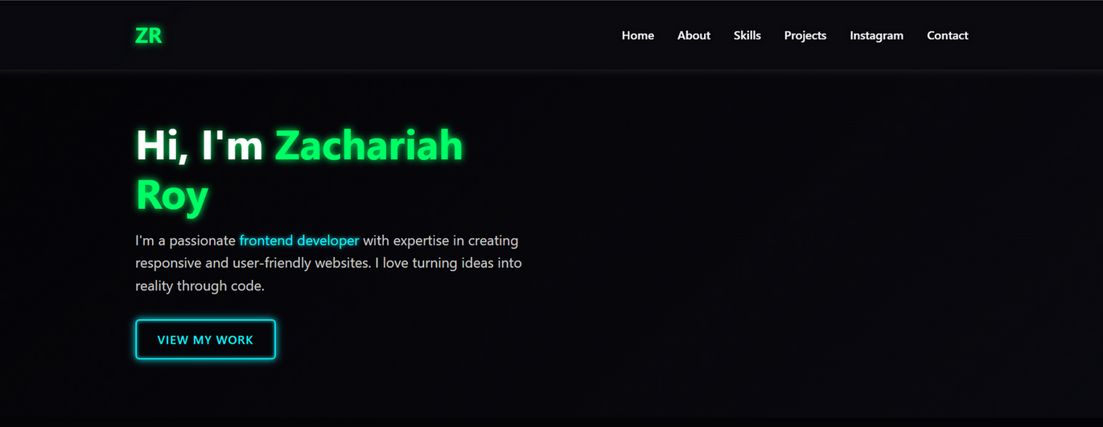
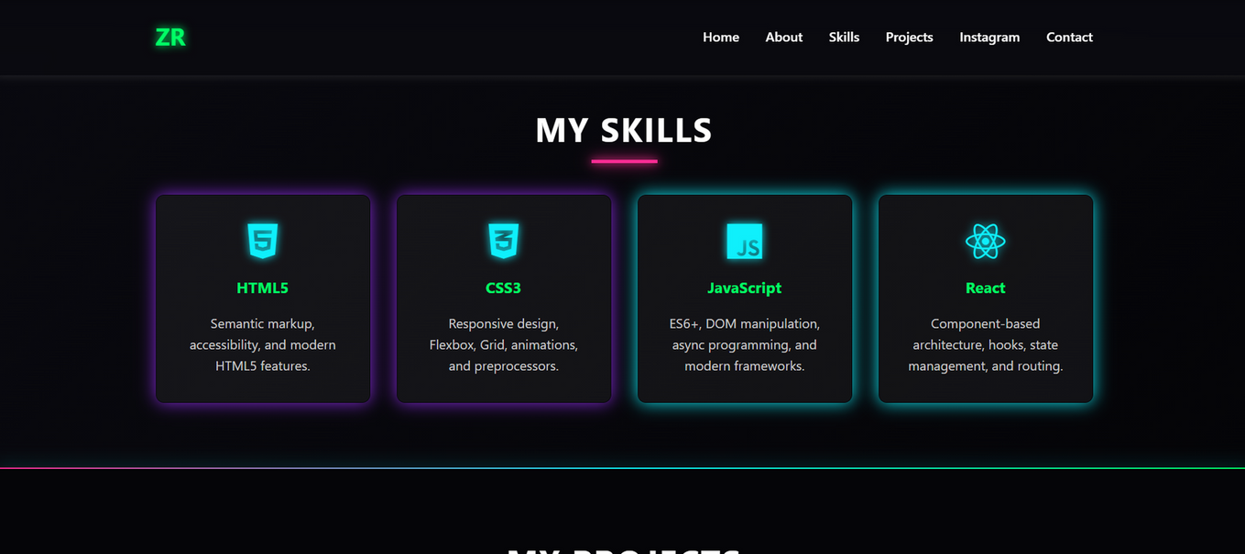
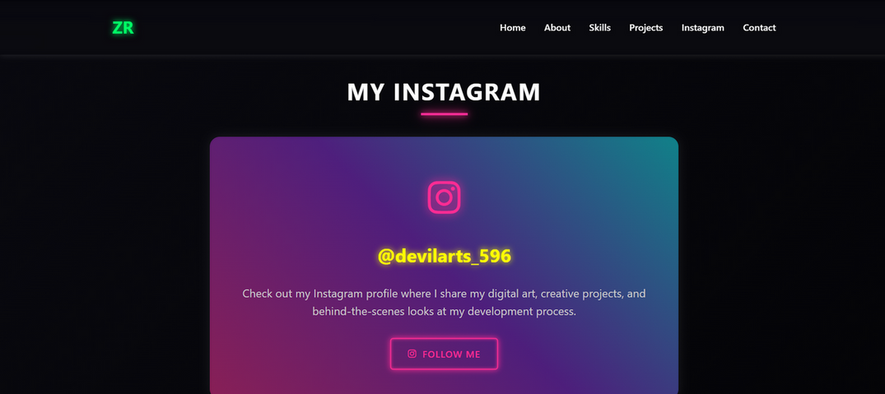

RESULTS AND SCREENSHOTS
3/21/2024 Annual Review
10

Slide 11

CONCLUSION
The portfolio successfully demonstrates Zachariah Roy’s frontend development skills while providing an engaging platform to showcase his work and personality. It highlights both technical expertise and design sense, making it a strong digital presence for professional opportunities.
11

Slide 12
SERVER LINK
https://github.com/24h221-code/TNSDC-FWD-DigitalPortfolio.git
DEPLOYMENT LINK
https://24h221-code.github.io/TNSDC-FWD-DigitalPortfolio/

